Slide 1
CS 2770: Computer Vision Neural Networks
Prof. Adriana Kovashka University of Pittsburgh
January 19, 2017

Slide 2
Plan for the next few lectures
Why (convolutional) neural networks?
Neural network basics
Architecture
Biological inspiration
Loss functions
Optimization / gradient descent
Training with backpropagation
Convolutional neural networks (CNNs)
Special operations
Common architectures
Understanding CNNs
Visualization
Synthesis / style transfer
Breaking CNNs
Practical matters
Tips and tricks for training
Transfer learning
Software packages

Slide 3
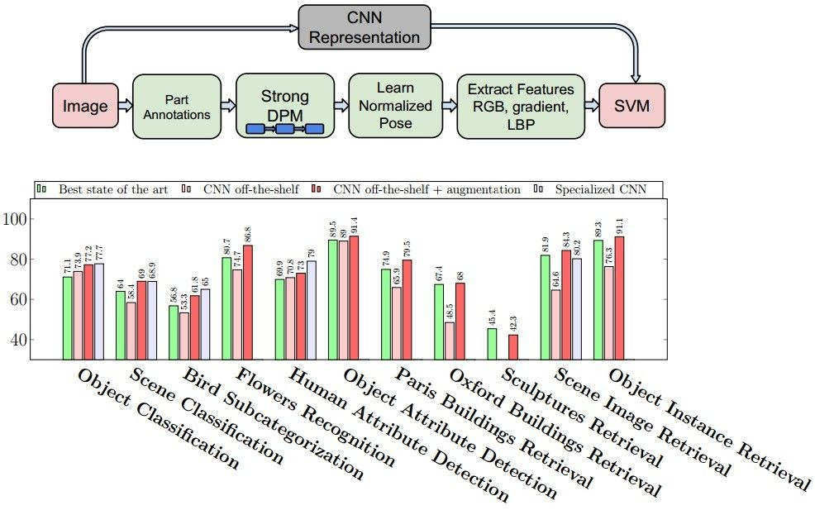
Why (convolutional) neural networks?
Obtained state of the art performance on many problems…
Most papers in CVPR 2016 use deep learning
Razavian et al., CVPR 2014 Workshops

Slide 4
ImageNet Challenge 2012
~14 million labeled images, 20k classes
Images gathered from Internet
Human labels via Amazon Turk
Challenge: 1.2 million training images, 1000 classes
[Deng et al. CVPR 2009]
A. Krizhevsky, I. Sutskever, and G. Hinton, ImageNet Classification with Deep Convolutional Neural Networks, NIPS 2012
Lana Lazebnik

Slide 5

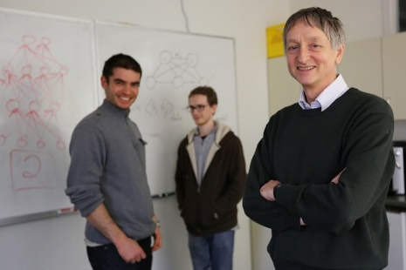
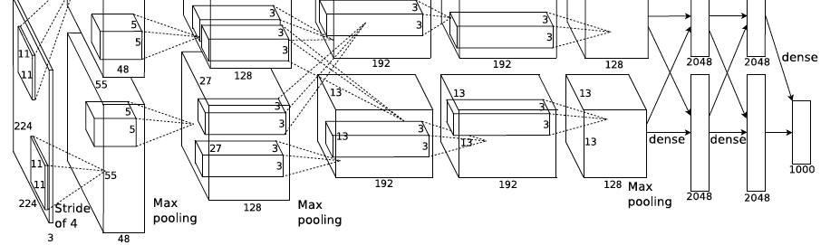
ImageNet Challenge 2012
AlexNet: Similar framework to LeCun’98 but:
Bigger model (7 hidden layers, 650,000 units, 60,000,000 params)
More data (10⁶ vs. 10³ images)
GPU implementation (50x speedup over CPU)
Trained on two GPUs for a week
Better regularization for training (DropOut)
A. Krizhevsky, I. Sutskever, and G. Hinton, ImageNet Classification with Deep Convolutional Neural Networks, NIPS 2012
Adapted from Lana Lazebnik
Notes:
Two-GPU architecture

Slide 6
ImageNet Challenge 2012
Krizhevsky et al. -- 16.4% error (top-5)
Next best (non-convnet) – 26.2% error
Lana Lazebnik

Slide 7
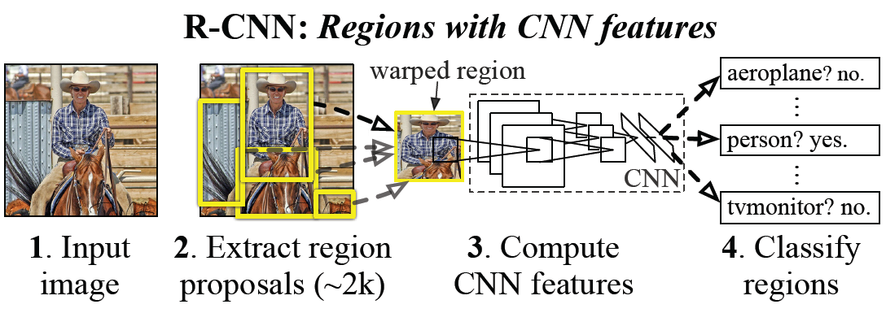
CNN features for detection
Object detection system overview. Our system (1) takes an input image, (2) extracts around 2000 bottom-up region proposals, (3) computes features for each proposal using a large convolutional neural network (CNN), and then (4) classifies each region using class-specific linear SVMs. R-CNN achieves a mean average precision (mAP) of 53.7% on PASCAL VOC 2010. For comparison, Uijlings et al. (2013) report 35.1% mAP using the same region proposals, but with a spatial pyramid and bag-of-visual-words approach. The popular deformable part models perform at 33.4%.
R. Girshick, J. Donahue, T. Darrell, and J. Malik, Rich Feature Hierarchies for Accurate Object Detection and Semantic Segmentation, CVPR 2014.
Lana Lazebnik

Slide 8
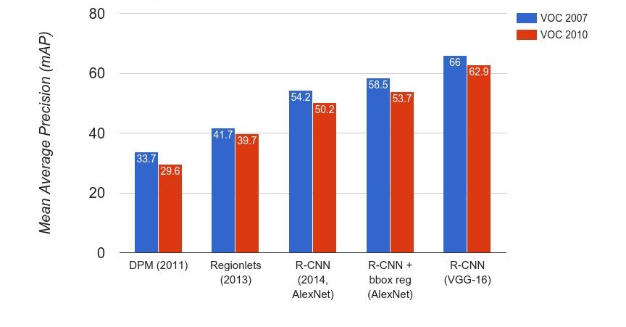
Object Detection
Andrej Karpathy

Slide 9
Object Detection
 | R-CNN (2014) | Fast R-CNN (2015)
Training Time: | 84 hours | 9.5 hours
(Speedup) | 1x | 8.8x
Test time per image | 47 seconds | 0.32 seconds
(Speedup) | 1x | 146x
mAP (VOC 2007) | 66.0 | 66.9
Faster!
FASTER!
Better!
Using VGG-16 CNN on Pascal VOC 2007 dataset
Adapted from Andrej Karpathy

Slide 10
Beyond classification
Detection
Segmentation
Regression
Pose estimation
Synthesis
and many more…
Adapted from Jia-bin Huang

Slide 11
What are CNNs?
Convolutional neural networks are a type of neural network
The neural network includes layers that perform special operations
Used in vision, but to a lesser extent also in NLP, biomedical, etc.
Often they are deep

Slide 12

Deep neural network
Figure from http://neuralnetworksanddeeplearning.com/chap5.html

Slide 13
Traditional Recognition Approach
Hand-designed feature extraction (e.g. SIFT, HOG)
Trainable classifier
Image/ Video
Pixels
Object Class
Features are key to recent progress in recognition, but research shows they’re flawed…
Where next? Better classifiers? Or keep building more features?
Adapted from Lana Lazebnik

Slide 14
What about learning the features?
Learn a feature hierarchy all the way from pixels to classifier
Each layer extracts features from the output of previous layer
Train all layers jointly
Image/ Video
Pixels
Layer 1
Layer 2
Layer 3
Simple Classifier
Lana Lazebnik
Notes:
Make clear that classic methods, e.g. convnets are purely supervised.

Slide 15
“Shallow” vs. “deep” architectures
Traditional recognition: “Shallow” architecture
Image/ Video
Pixels
Hand-designed feature extraction
Trainable classifier
Object Class
Deep learning: “Deep” architecture
Image/ Video
Pixels
Layer 1
Layer N
Simple classifier
…
Object Class
Lana Lazebnik

Slide 16
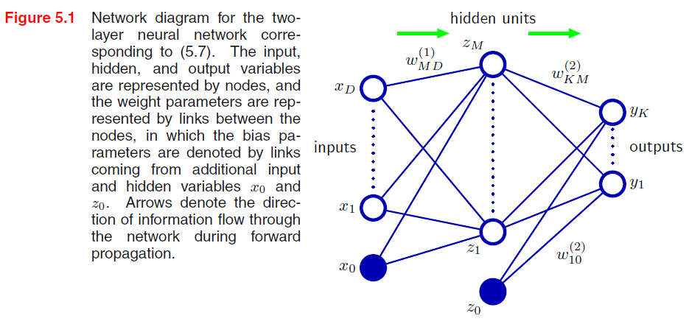
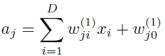
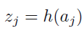
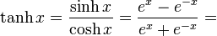
Neural network definition
Activations:
Nonlinear activation function h (e.g. sigmoid, tanh):
Recall SVM:
w^{T}x + b
Figure from Christopher Bishop

Slide 17
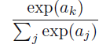
Neural network definition
Layer 2
Layer 3 (final)
Outputs
Finally:
(multiclass)
(binary)
(binary)

Slide 18
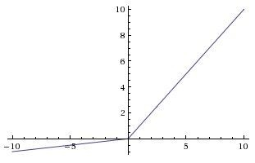
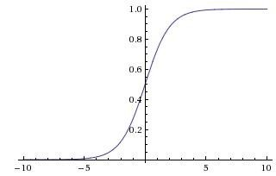
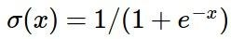
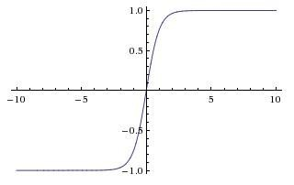
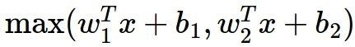
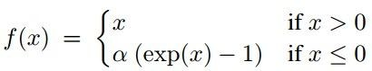
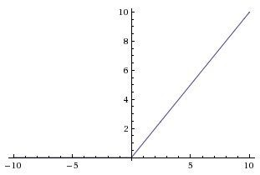
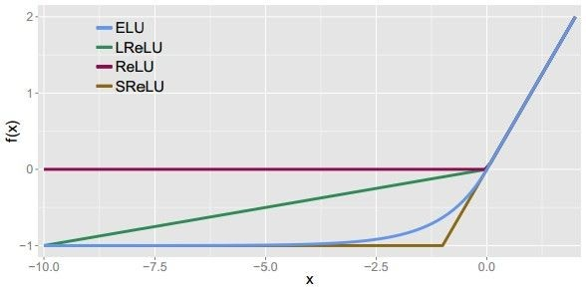
Leaky ReLU
max(0.1x, x)
Activation functions
Sigmoid
Maxout ELU
tanh
tanh(x)
ReLU
max(0,x)
Andrej Karpathy

Slide 19
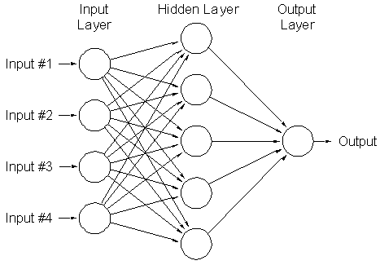
A multi-layer neural network
Nonlinear classifier
Can approximate any continuous function to arbitrary accuracy given sufficiently many hidden units
Lana Lazebnik

Slide 20


Inspiration: Neuron cells
Neurons
accept information from multiple inputs,
transmit information to other neurons.
Multiply inputs by weights along edges
Apply some function to the set of inputs at each node
If output of function over threshold, neuron “fires”
Text: HKUST, figures: Andrej Karpathy
Notes:
From Wikipedia: At the majority of synapses, signals are sent from the axon of one neuron to a dendrite of another... All neurons are electrically excitable, maintaining voltage gradients across their membranes… If the voltage changes by a large enough amount, an all-or-none electrochemical pulse called an action potential is generated, which travels rapidly along the cell's axon, and activates synaptic connections with other cells when it arrives.

Slide 21
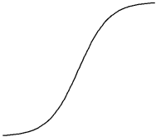
A neuron
Input
Weights
x₁
w₁
x₂
w₂
Output: σ(w⋅x + b)
x₃
w₃
.
.
.
Sigmoid function:
w_{d}
x_{d}
Lana Lazebnik

Slide 22
Multilayer networks
Cascade neurons together
Output from one layer is the input to the next
Each layer has its own sets of weights
HKUST

Slide 23
Feed-forward networks
Predictions are fed forward through the network to classify
HKUST

Slide 24
Feed-forward networks
Predictions are fed forward through the network to classify
HKUST

Slide 25
Feed-forward networks
Predictions are fed forward through the network to classify
HKUST

Slide 26
Feed-forward networks
Predictions are fed forward through the network to classify
HKUST

Slide 27
Feed-forward networks
Predictions are fed forward through the network to classify
HKUST

Slide 28
Feed-forward networks
Predictions are fed forward through the network to classify
HKUST

Slide 29
Deep neural networks
Lots of hidden layers
Depth = power (usually)
Weights to learn!
Weights to learn!
Weights to learn!
Weights to learn!
Figure from http://neuralnetworksanddeeplearning.com/chap5.html

Slide 30
How do we train them?
The goal is to iteratively find such a set of weights that allow the activations/outputs to match the desired output
We want to minimize a loss function
The loss function is a function of the weights in the network
For now let’s simplify and assume there’s a single layer of weights in the network

Slide 31
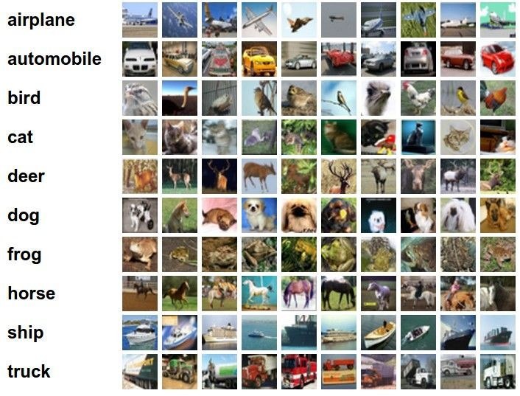
Classification goal
Example dataset: CIFAR-10 10 labels
50,000 training images each image is 32x32x3
10,000 test images.
Andrej Karpathy

Slide 32
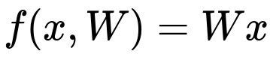
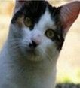
Classification scores
image
parameters
f(x,W)
10 numbers, indicating class scores
[32x32x3]
array of numbers 0...1 (3072 numbers total)
Andrej Karpathy

Slide 33
Linear classifier
3072x1
(+b)
10x1
10x1
10x3072
10 numbers, indicating class scores
[32x32x3]
array of numbers 0...1
parameters, or “weights”
Andrej Karpathy

Slide 34
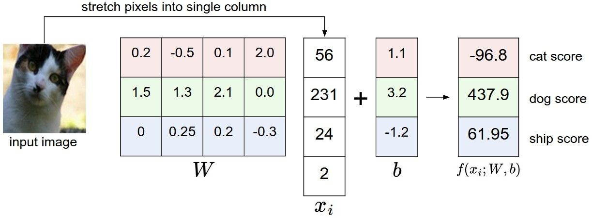
Linear classifier
Example with an image with 4 pixels, and 3 classes (cat/dog/ship)
Andrej Karpathy

Slide 35

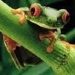
Linear classifier
Going forward: Loss function/Optimization
TODO:
1. Define a loss function that quantifies our unhappiness with the scores across the training data.
-3.45
-8.87
0.09
2.9
4.48
8.02
3.78
1.06
-0.36
-0.72
-0.51
6.04
5.31
-4.22
-4.19
3.58
4.49
-4.37
-2.09
-2.93
3.42
4.64
2.65
5.1
2.64
5.55
-4.34
-1.5
-4.79
6.14
2. Come up with a way of efficiently finding the parameters that minimize the loss function. (optimization)
Andrej Karpathy

Slide 36
Linear classifier
Suppose: 3 training examples, 3 classes. With some W the scores
are:
cat car frog
3.2
5.1
-1.7
1.3
4.9
2.0
2.2
2.5
-3.1
Andrej Karpathy

Slide 37
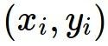
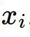
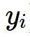
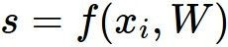
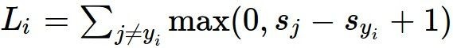
Linear classifier: SVM loss
Suppose: 3 training examples, 3 classes. With some W the scores
Multiclass SVM loss:
Given an example
are:
where where
is the image and
is the (integer) label,
and using the shorthand for the scores vector:
cat car frog
the SVM loss has the form:
3.2
5.1
-1.7
1.3
4.9
2.0
2.2
2.5
-3.1
Andrej Karpathy

Slide 38
Linear classifier: SVM loss
Suppose: 3 training examples, 3 classes. With some W the scores
Multiclass SVM loss:
Given an example
are:
where where
is the image and
is the (integer) label,
and using the shorthand for the scores vector:
the SVM loss has the form:
cat car frog | 3.2 5.1 -1.7 | 1.3 2.2 4.9 2.5 2.0 -3.1
Losses: | 2.9
= max(0, 5.1 - 3.2 + 1)
+max(0, -1.7 - 3.2 + 1)
= max(0, 2.9) + max(0, -3.9)
= 2.9 + 0
= 2.9
Andrej Karpathy

Slide 39
Linear classifier: SVM loss
Suppose: 3 training examples, 3 classes. With some W the scores
Multiclass SVM loss:
Given an example
are:
where where
is the image and
is the (integer) label,
and using the shorthand for the scores vector:
the SVM loss has the form:
cat 3.2 car 5.1 frog -1.7 | 1.3 4.9 2.0 | 2.2 2.5 -3.1
Losses: 2.9 | 0
= max(0, 1.3 - 4.9 + 1)
+max(0, 2.0 - 4.9 + 1)
= max(0, -2.6) + max(0, -1.9)
= 0 + 0
= 0
Andrej Karpathy

Slide 40
Linear classifier: SVM loss
Suppose: 3 training examples, 3 classes. With some W the scores
Multiclass SVM loss:
Given an example
are:
where where
is the image and
is the (integer) label,
and using the shorthand for the scores vector:
the SVM loss has the form:
cat car frog | 3.2 5.1 -1.7 | 1.3 4.9 2.0 | 2.2 2.5 -3.1
Losses: | 2.9 | 0 | 12.9
= max(0, 2.2 - (-3.1) + 1)
+max(0, 2.5 - (-3.1) + 1)
= max(0, 5.3 + 1)
+ max(0, 5.6 + 1)
= 6.3 + 6.6
= 12.9
Adapted from Andrej Karpathy

Slide 41
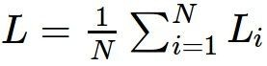
Linear classifier: SVM loss
Suppose: 3 training examples, 3 classes. With some W the scores
Multiclass SVM loss:
Given an example
are:
where where
is the image and
is the (integer) label,
and using the shorthand for the scores vector:
cat car frog
the SVM loss has the form:
3.2
5.1
-1.7
1.3
4.9
2.0
2.2
2.5
-3.1
and the full training loss is the mean over all examples in the training data:
L = (2.9 + 0 + 12.9)/3
Losses:
2.9
0
12.9
= 15.8 / 3 = 5.3
Lecture 3 - 12
Adapted from Andrej Karpathy

Slide 42
Linear classifier: SVM loss
Andrej Karpathy

Slide 43
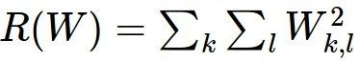
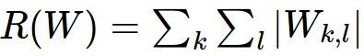
Linear classifier: SVM loss
λ = regularization strength (hyperparameter)
Weight Regularization
In common use: L2 regularization L1 regularization
Dropout (will see later)
Adapted from Andrej Karpathy

Slide 44
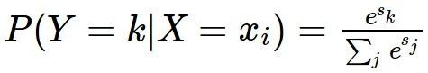
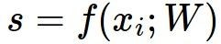
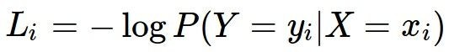
Another loss: Softmax
scores = unnormalized log probabilities of the classes.
where
cat car frog
Want to maximize the log likelihood, or (for a loss function) to minimize the negative log likelihood of the correct class:
3.2
5.1
-1.7
Andrej Karpathy

Slide 45
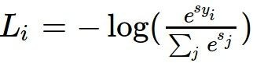
Another loss: Softmax
unnormalized probabilities
cat car frog
3.2 5.1 -1.7 | exp
0.13
0.87
0.00
24.5
164.0
0.18
L_i = -log(0.13)
= 0.89
normalize
unnormalized log probabilities
probabilities
Adapted from Andrej Karpathy

Slide 46
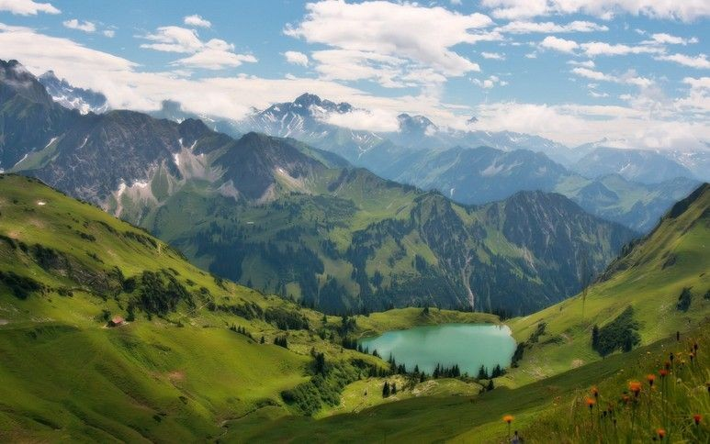

How to minimize the loss function?
Andrej Karpathy

Slide 47
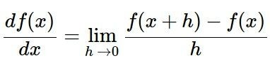
How to minimize the loss function?
In 1-dimension, the derivative of a function:
In multiple dimensions, the gradient is the vector of (partial derivatives).
Andrej Karpathy

Slide 48
current W:
gradient dW:
[0.34,
-1.11,
0.78,
0.12,
0.55,
2.81,
-3.1,
-1.5,
0.33,…]
loss 1.25347
[?,
?,
?,
?,
?,
?,
?,
?,
?,…]
Andrej Karpathy

Slide 49
current W:
W + h (first dim):
gradient dW:
[0.34,
-1.11,
0.78,
0.12,
0.55,
2.81,
-3.1,
-1.5,
0.33,…]
loss 1.25347
[0.34 + 0.0001,
-1.11,
0.78,
0.12,
0.55,
2.81,
-3.1,
-1.5,
0.33,…]
loss 1.25322
[?,
?,
?,
?,
?,
?,
?,
?,
?,…]
Andrej Karpathy

Slide 50
current W:
W + h (first dim):
gradient dW:
[0.34,
-1.11,
0.78,
0.12,
0.55,
2.81,
-3.1,
-1.5,
0.33,…]
loss 1.25347
[0.34 + 0.0001,
-1.11,
0.78,
0.12,
0.55,
2.81,
-3.1,
-1.5,
0.33,…]
loss 1.25322
[-2.5,
?,
?,
?,
?,
?,
?,
(1.25322 - 1.25347)/0.0001
= -2.5
?,
?,…]
Andrej Karpathy

Slide 51
current W:
W + h (second dim):
gradient dW:
[0.34,
-1.11,
0.78,
0.12,
0.55,
2.81,
-3.1,
-1.5,
0.33,…]
loss 1.25347
[0.34,
-1.11 + 0.0001,
0.78,
0.12,
0.55,
2.81,
-3.1,
-1.5,
0.33,…]
loss 1.25353
[-2.5,
?,
?,
?,
?,
?,
?,
?,
?,…]
Andrej Karpathy

Slide 52
current W:
W + h (second dim):
gradient dW:
[0.34,
-1.11,
0.78,
0.12,
0.55,
2.81,
-3.1,
-1.5,
0.33,…]
loss 1.25347
[0.34,
-1.11 + 0.0001,
0.78,
0.12,
0.55,
2.81,
-3.1,
-1.5,
0.33,…]
loss 1.25353
[-2.5,
0.6,
?,
?,
?,
?,
?,
?,
(1.25353 - 1.25347)/0.0001
= 0.6
?,…]
Andrej Karpathy

Slide 53
current W:
W + h (third dim):
gradient dW:
[0.34,
-1.11,
0.78,
0.12,
0.55,
2.81,
-3.1,
-1.5,
0.33,…]
loss 1.25347
[0.34,
-1.11,
0.78 + 0.0001,
0.12,
0.55,
2.81,
-3.1,
-1.5,
0.33,…]
loss 1.25347
[-2.5,
0.6,
?,
?,
?,
?,
?,
?,
?,…]
Andrej Karpathy

Slide 54
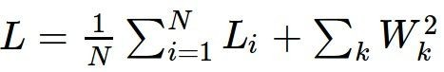
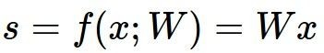
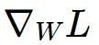
This is silly. The loss is just a function of W:
want
Andrej Karpathy

Slide 55

This is silly. The loss is just a function of W:
want
Calculus
= ...
Andrej Karpathy

Slide 56
current W:
gradient dW:
[0.34,
-1.11,
0.78,
0.12,
0.55,
2.81,
-3.1,
-1.5,
0.33,…]
loss 1.25347
[-2.5,
0.6,
0,
0.2,
0.7,
-0.5,
1.1,
1.3,
-2.1,…]
dW = ...
(some function data and W)
Andrej Karpathy

Slide 57
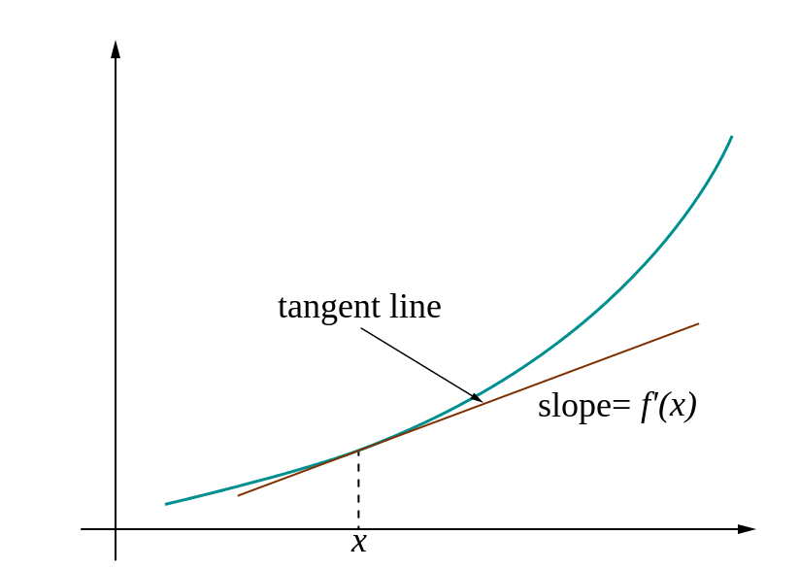
Loss gradients
Denoted as (diff notations):
i.e. how does the loss change as a function of the weights
We want to change the weights in such a way that makes the loss decrease as fast as possible

Slide 58
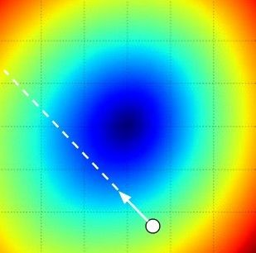
Gradient descent
We’ll update weights
Move in direction opposite to gradient:
L
Time
Learning rate
W_2
original W
W_1
negative gradient direction
Figure from Andrej Karpathy

Slide 59
Gradient descent
Iteratively subtract the gradient with respect to the model parameters (w)
I.e. we’re moving in a direction opposite to the gradient of the loss
I.e. we’re moving towards smaller loss

Slide 60
Mini-batch gradient descent
In classic gradient descent, we compute the gradient from the loss for all training examples
Could also only use some of the data for each gradient update
We cycle through all the training examples multiple times
Each time we’ve cycled through all of them once is called an ‘epoch’
Allows faster training (e.g. on GPUs), parallelization

Slide 61
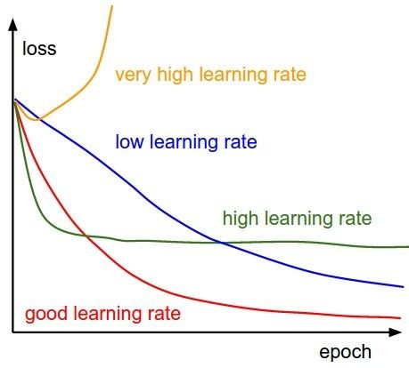
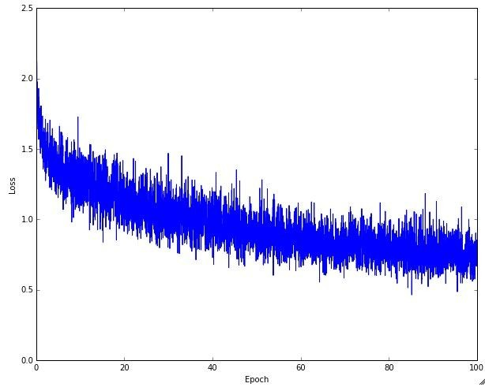
Learning rate selection
The effects of step size (or “learning rate”)
Andrej Karpathy

Slide 62
Gradient descent in multi-layer nets
We’ll update weights
Move in direction opposite to gradient:
How to update the weights at all layers?
Answer: backpropagation of error from higher layers to lower layers

Slide 63
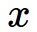
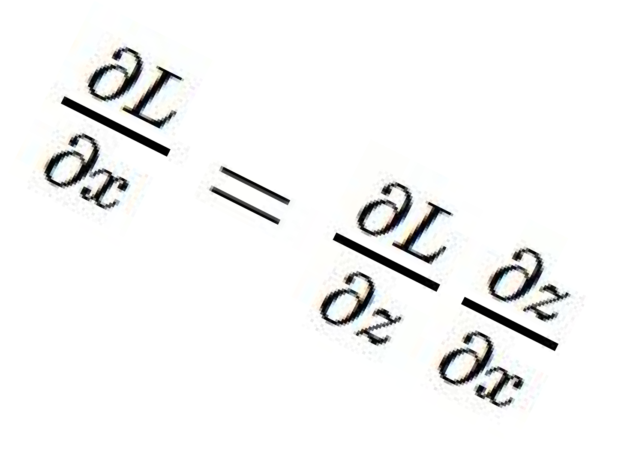
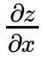
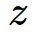



activations
Backpropagation
“local gradient”
f
gradients
More info:
https://www.youtube.com/watch?v=QWfmCyLEQ8U&list=PL16j5WbGpaM0_Tj8CRmurZ8Kk1gEBc7fg&index=4
Andrej Karpathy

Slide 64
Backpropagation: Graphic example
First calculate error of output units and use this to change the top layer of weights.
output
k
j
i
Update weights into j
hidden
input
Adapted from Ray Mooney, equations from Chris Bishop

Slide 65
Backpropagation: Graphic example
Next calculate error for hidden units based on errors on the output units it feeds into.
output
k
j
i
hidden
input
Adapted from Ray Mooney, equations from Chris Bishop

Slide 66
Backpropagation: Graphic example
Finally update bottom layer of weights based on errors calculated for hidden units.
output
k
j
i
Update weights into i
hidden
input
Adapted from Ray Mooney, equations from Chris Bishop

Slide 67
Comments on training algorithm
Not guaranteed to converge to zero training error, may converge to local optima or oscillate indefinitely.
However, in practice, does converge to low error for many large networks on real data.
Thousands of epochs (epoch = network sees all training data once) may be required, hours or days to train.
To avoid local-minima problems, run several trials starting with different random weights (random restarts), and take results of trial with lowest training set error.
May be hard to set learning rate and to select number of hidden units and layers.
Neural networks had fallen out of fashion in 90s, early 2000s; back with a new name and significantly improved performance (deep networks trained with dropout and lots of data).
Ray Mooney, Carlos Guestrin, Dhruv Batra

Slide 68
Over-training prevention
Running too many epochs can result in over-fitting.
Keep a hold-out validation set and test accuracy on it after every epoch. Stop training when additional epochs actually increase validation error.
error
on test data
on training data
0
# training epochs
Adapted from Ray Mooney

Slide 69
Determining best number of hidden units
Too few hidden units prevents the network from adequately fitting the data.
Too many hidden units can result in over-fitting.
Use internal cross-validation to empirically determine an optimal number of hidden units.
error
on test data
on training data
0
# hidden units
Ray Mooney

Slide 70
A note on training
The more weights you need to learn, the more data you need
That’s why with a deeper network, you need more data for training than for a shallower network
That’s why if you have sparse data, you only train the last few layers of a deep net
Set these to the already learned
weights from another network
Learn these on your own task

Slide 71

Effect of number of neurons
more neurons = more capacity
Andrej Karpathy

Slide 72

Do not use size of neural network as a regularizer. Use stronger regularization instead:
Effect of regularization
(you can play with this demo over at ConvNetJS: http://cs.stanford. edu/people/karpathy/convnetjs/demo/classify2d.html)
Andrej Karpathy

Slide 73
Hidden unit interpretation
Trained hidden units can be seen as newly constructed features that make the target concept linearly separable in the transformed space.
On many real domains, hidden units can be interpreted as representing meaningful features such as vowel detectors or edge detectors, etc.
However, the hidden layer can also become a distributed representation of the input in which each individual unit is not easily interpretable as a meaningful feature.
Ray Mooney

Slide 74
Summary
We use deep neural networks because of their strong performance in practice
Feed-forward network architecture
Training deep neural nets
We need an objective function that measures and guides us towards good performance
We need a way to minimize the loss function: stochastic gradient descent
We need backpropagation to propagate error towards all layers and change weights at those layers
Practices for preventing overfitting

